Slide 1
C++ programming language

Slide 2
Programming language C
The programming language C in 1970 was developed in AT&A Bell Laboratories by Dennis Ritchie. Language C is considered to be something between the high and low levels of programming languages.
C language deficiencies:
programs that are written on it not easy to understand,
do not have built-in automatization,
do not have high level constructions.

Slide 3
Programming language C ++
Language C++ was developed from language C Programming language C++ was developed at the end of 20th century (70^{th-}80th) in AT&A Bell Laboratories by Bjarne Stroustrup
Many high-level constructions was introduced to make it easier for understanding. C++ saved full compatibility with C language. C++ language is still combines both low and high level constructions.

Slide 4
Programming language C ++
C++
Functional capabilities to provide Object-oriented programming
C
Functional capabilities Common for C and C++
Functional capabilities that typically do not use C++
Other functional features

Slide 5
First C++ program
You do not need to enter line numbers when you type the program text. C++ language is case sensitive – replacing the main to Main or MAIN will make program nonfunctional!
#include <iostream>
using namespace std;
int main()
{
cout << "Hello , World !" << endl ;
system ("pause");
return 0;
}
Save file as hello.cpp
Compile and Run (F11)

Slide 6
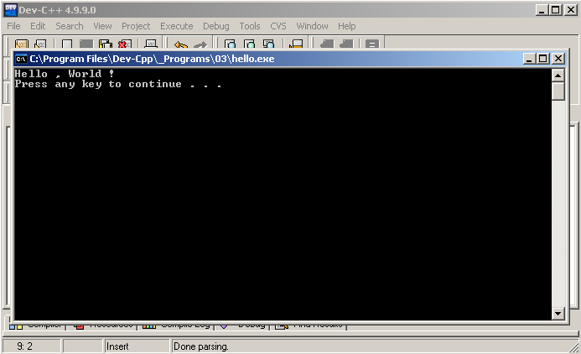
First C++ program
Result
If everything was correct you'll see "Hello World!" To exit a program press any key.

Slide 7
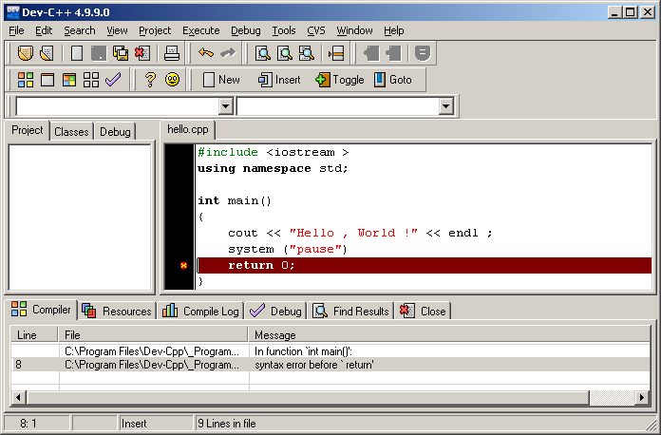
First C++ program
If there is an error in compilation, you will have the appropriate message.

Slide 8
Program analysis
#include <iostream>
using namespace std;
int main()
{
cout << "Hello , World !" << endl ;
system ("pause");
return 0;
}
Input/Output streams support
Use functions from the C++ standard libraries. Blank lines will be ignored, it can be used to improve code understanding.
main() — main C++ function; keyword int means that the function will return the integer value.
and 9. – function body enclosed in braces

Slide 9
Program analysis
#include <iostream>
using namespace std;
int main()
{
cout << "Hello , World !" << endl ;
system ("pause");
return 0;
}
cout is the name of the object that provides information output to the screen, output objects need to be separated by “<<” symbols, endl moves the cursor to the new line. system ("pause") waits until any key is pressed and will not allow the program window to close. Program exiting point, value “0” is returned as result.

Slide 10
Notes
Compiler ignores blank lines The transition to the next line and indentation also does not affect compiler work.
The following program is completely equivalent to previous:
#include <iostream> using namespace std;int main (){ cout <<
"Hello , World !"<< endl ; system ("pause"); return 0;}
To improve the readability of the code, you should use indents and blank lines. Almost all programs ends with “;”
#include <iostream> command means: "Include to program iostream library"

Slide 11
Practice
Change the program code to output another line of text “I Love C++”. How many times cout object was used? Try change the program code to use it only once.

Slide 12
Comments in C++ language
Using of comments allows you to leave comments about complicated code, or usage of nonstandard solutions. A comment is a sequence of symbols ignored by compiler.
#include <iostream>
using namespace std;
int main() //main program function
{
cout << "Hello , World !" << endl; //text output
system ("pause");
return 0;
} //end of the program
All text inserted after "//" symbols till the end of line belong to comment.

Slide 13
Comments in C++ language
#include <iostream>
using namespace std;
int main() // main program function
{
cout << "Hello , World !" << endl; // text output
/* Here is vary long comment
which consist of several lines
cout << ”I love C++”;
end of the long comment */
system ("pause");
return 0;
} // end of the program
All the text between “/*” and “*/” simbols belongs to comment.
Comments can also be used during the debugging of application by including pieces of suspicious code to comments.

Slide 14
Variables
resolving an equation: a + x = b
#include <iostream>
using namespace std;
int main()
{
double a, b;
cout << "Input a: ";
cin >> a;
cout << "Input b: ";
cin >> b;
double x = b-a;
cout << "Root of equation a+x=b is " << x << endl;
system ("pause");
return 0;
}

Slide 15
Variables
cin is the name of the object that provide input in console mode, all data you need to input must be separated with “>>” symbols
double a, b; variable definition
double x = b-a; variable definition and assignment of initial value.

Slide 16
Variables
We need to store a data somewhere
All the variables in C++ language must be defined before using them. In C++, a variable can be defined in any place, but:
It is not allowed to define multiple variables with the same name in the same block (the block continues from an opening brace to a closing brace) You can use a variable immediately after you defined it and until the current block ends (to the nearest closing brace)

Slide 17
Variable types in C++
Basic types
Keyword Low High Dig. of Prec. Bytes
char -128 127 n/a 1
short -32’768 32’767 n/a 2
int -2’147’483’648 2’147’483’647 n/a 4
long -2’147’483’648 2’147’483’647 n/a 4
float 3.4*10⁻³⁸ 3.4*10³⁸ 7 4
double 1.7*10⁻³⁰⁸ 1.7*10³⁰⁸ 15 8
long double 3.4*10⁻⁴⁹³² 3.4*10⁴⁹³² 19 16
bool false true n/a 1
Unsigned Integer Types
Keyword Low High Bytes
unsigned char 0 255 1
unsigned short 0 65’535 2
unsigned int 0 4’294’967’295 4
unsigned long 0 4’294’967’295 4

Slide 18
Variable names
In variable names you can use
Latin characters A-Z, a-z Underlining symbol Digits 0-9
Variables and function names
Can not begin with a number does not recommend to start and end with the underlining symbol should not match the reserved keywords (int, return,...)
Examples:
Allowed names: a, b, x1, y_42, day_of_week, num_of_students, route_66
Not allowed names: 3rd_law, double
Not recommended names: _temp_var, new_var_

Slide 19
Namespaces
A program to demonstrate need of namespace
int main()
{
int value;
value = 0;
double value; // Error here
value = 0.0;
}
Compiler Error: 'value' has a previous declaration as 'int value'
In each scope, a name can only represent one entity. So, there cannot be two variables with the same name in the same scope.

Slide 20
Namespaces
Using namespaces, we can create two variables or member functions having the same name.
#include <iostream>
using namespace std;
namespace first
{
int val = 500; // Variable created inside namespace
}
int main()
{
int val = 200; // Local variable
// namespace variables can be accessed from
// outside the namespace using the scope operator ::
cout << first::val << '\n';
return 0;
}
Output:
500

Slide 21
Arithmetical operators
“=“ Assignment (variable-binding) operator
“+” Addition operator
“−” Subtraction operator
“*” Multiplication operator
“/” Division operator (6/4 → 1, 6.0/4 → 1.5, 6/4.0 → 1.5)
“%” Modulo operation - finds the remainder after division of one number by another (sometimes called modulus) (6%4 → 2, 13%6 → 1)

Slide 22
Practice
Write the program that contains the following variables definition.
int a = 13/5;
int b = 13%5;
int c = 13.0/5;
double d = 13/5;
double e = 13%5;
double f = 13.0/5;
double g = 13/5 + 2/5;
double h = 13.0/5 + 2.0/5;
int i = 13.0/5 + 2.0/5;
Output it to the screen, explain why it got exactly that values.

Slide 23
Practice
There are two integer variables. Write an application that swaps the values of the variables (a=2, b=3 -> a=3, b=2).
Input x. Calculate x⁴.
Input x. Calculate x⁷ using only 4 multiplication operators.
Input x. Calculate x¹³ using only 5 multiplication operators.
Input natural number. Output it’s last digit.

Slide 24
Practice
Input a speed in km/h and convert it to m/s. Program requires 3 assessment marks and calculates the average.
Knowing the cube edge length, calculate the cube volume, its surface area and side diagonal length.

Slide 25
Practice
Input two integer variables. Write a program that swaps the values for the variables (a=2, b=3 -> a=3, b=2), without using an additional variable. There are three integer variables h, m, s. Find the angle (in degrees) between hour's arrow at midnight and the hour arrow at the moment h:m:s.

